Slide 1

Database Design for Lake Ridge Community Hospital
DBAS 5206
Group 6
Bei J, Chiao C, Vishwa P, Yuqi Z

Slide 2

Introduction
Durham Region as a whole as well as people from Oshawa are treated at Lake Ridge City Hospital, a hospital located in Oshawa. The hospital plans to call for expansion to 200 beds soon. Currently, LRCH is using a batch-oriented system, which means all the various dashboards, such as Patient Accounts, Billing, Financial Accounting, and Accounts Receivable are divided separately and NOT connected.
Management at LRCH has recognized that the present information systems were not responsive to their needs. Our goal is to design a better development database system and get approval for being officially used in LRCH.
This presentation will demonstrate our mission statements, the current database issues and effects, new database design ideas, newly designed database system (ERD), dashboards, and how our new database system will benefit LRCH.

Slide 3

Mission Statement ⭐
Provides secure and efficient database solutions to support hospital data management by improving system efficiency and tracking capabilities.

Slide 4
Current Database System Issues & Effects
The current system does not support the medical staff in recording or reporting the results of laboratory tests and procedures. This might lead to future disagreements.
All prescriptions are written on paper, there is a potential that they might go misplaced.
Since the entire system is batch-oriented, it does not support immediate system-wide access for processes like patient registration or inquiries regarding billing which can delay all sorts of things until the batches are executed overnight.
The system does not accumulate costs by department or cost center, making it quite hard to get an idea about the state of costs by department.
The system is inflexible and does not respond well to changing management needs. For instance, If any patient comes and wants to make changes frequently, it will take more than a day to process the changes.

Slide 5
New Database System Ideas
Our team has decided to create a system that is entirely separated into two components:
The room usage Dashboard displays: All relevant information on each room, including the kind, location, and number of unoccupied rooms, and the date on which patients were discharged from each room.
The physician-patient Dashboard displays: All of the necessary patient details, physician details, report bill details, and transaction details for the entire day.

Slide 6

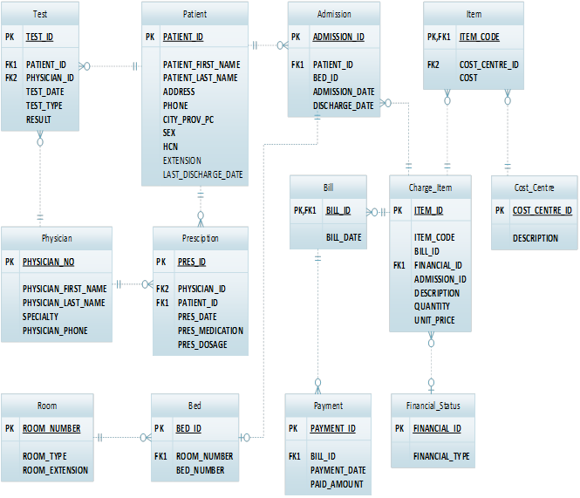




What is this database look like?

Slide 7
Dashboards
Our database design includes data related to various fields in the hospital, which enables us to obtain all the necessary data to integrate into useful information and reports.
Overall Occupancy by Rooms
Overall Occupancy by Beds
Occupancy by Room Type
# of Beds Discharging Patients Today
# of Empty Rooms by Room Type

Slide 8
Dashboards
Physician-Patient Dashboard
A physician should have a window in which they can:
be presented with all the patients of theirs currently in the hospital.
view individual patient details including:
total number of appointments
personal data
previous and upcoming treatments
the ability to assign treatments to a patient.
have the option to save individual notes about a patient.

Slide 9





Why Us?
We Know
Hospital
Bei
Chiao
WHY US?
We are from…
Strong and
Diversified Team
Vishwa
Yuqi

Slide 10




Slide 11


